Slide 1

CLIQUE – Experience Luxury At Convenience

Slide 2








WAIŪ : Mission, Vision & Values
Mission:
To create a global service provider of hospitality industry, realizing pioneering advancements in established services and accomplish mutual growth for both our partners & customers
Vision:
WAIŪ is dedicated to provide modern & innovative solutions to our hospitality partners, via introduction of technology evolution in their offerings and creating avenues of inspiring new business horizons.
Values:
Innovation through Leadership : To become vanguard of hospitality experience enrichment
Modernization & Elegance : To develop ultramodern hospitality business solutions
Focus & Evolution : Relentlessly strive to improve business value through performance

Slide 3
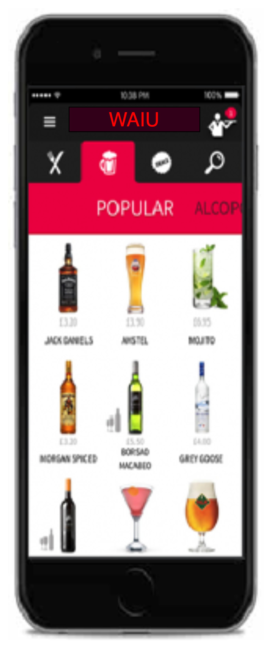








Product & Features
F&B Services
Instant cashback facility for regular customers to avail restaurant services
Broadcast & Live Streaming
Watch exclusive live shows of your favorite artists & performers
Gift a Friend
Gift or share an item of choice to your beloved ones – Family & Friends, Colleagues, Corporates
Clique - Dine Now, Pay Later
Privileged credit services for the our NBFC/MFI partner’s customers
Offer a New Friend
Offer service will be availed at merchant establishment with other groups or individuals
Events & Gaming
Promote corporate events, interactive games for in-house patrons
Payments & PBS
Express true feeling of sharing & gifting with points instead of money
Logistics & Governance
Reduced expenses through aggregator independence, merchant governance support & staff training

Slide 4



Clique – The Opportunity
Clique is premium service offered to our finest customers & business partners, to mutually benefit through means of microfinancing services.
Clique will be a unique solution focused on hospitality industry, that has been consistently growing & creating pristine opportunities for restaurants & its ever-growing youthful consumer base.
Clique is designed to promote inclusive growth in hospitality industry by introducing flexible borrowing as channel partners, while simultaneously allowing ease of doing business and comfortable provisions.
With microfinance market anticipated to grow with CAGR of 40% through 2025, NBFC-MFIs will be its greatest beneficiaries. In F&B segment, unbanked microlending has only reached 12-15% of the prospective market.

Slide 5
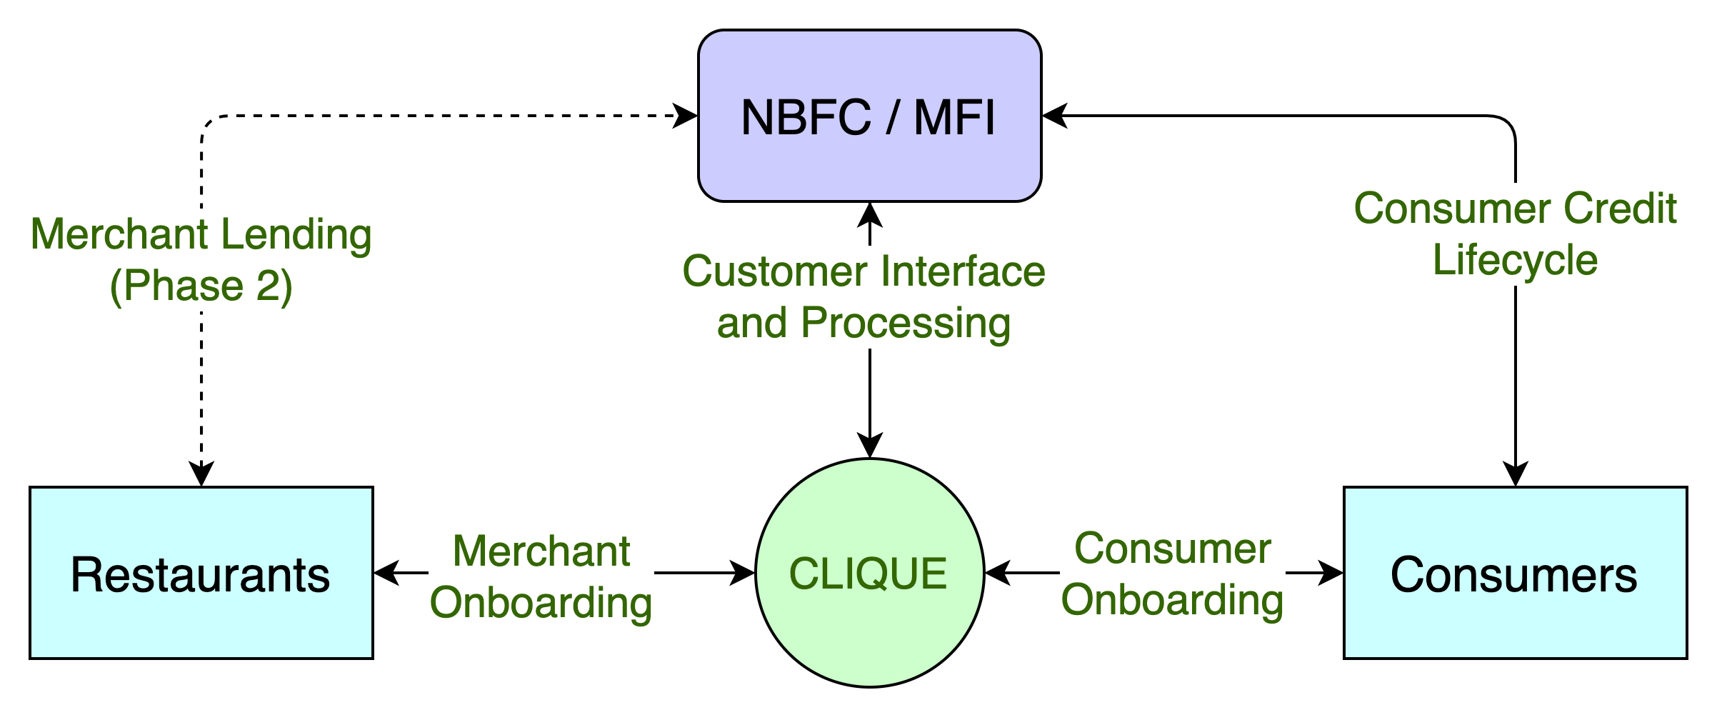
Clique – High Level System Flow
CASE STUDIES
Zomato, in partnership with InCred, to lend Rs 1L to 50k restaurants, developing loan book of 500CR
PAYO (Australia) – Launched ENPL service in July-21 & already has 500+ restaurant partners

Slide 6
Clique – 360° Benefits
Eat now, Pay Later
Consumers | Restaurants | MFI-NBFC
Increase in spend potential | Increased sales | New customers
Bio-authorization to reduce risks | Higher ticket size | Increased presence
No joining or renewal fees | New feature to offer | Competitive edge
Decorum & savings | No additional charges | Innovative offer
Microfinancing
Consumers | Restaurants | MFI-NBFC
Increased borrowing potential | Self-sufficiency at competitive rates | Untapped market – Millennials, Zoomers
Enhanced financial literacy | Standardized & organized system | Inclusive growth
Reactive credit scoring | Reduced regulatory challenges | Valued partnership
Better rates than banks | Co-branding opportunities | Benefit from geographic expansions

Slide 7
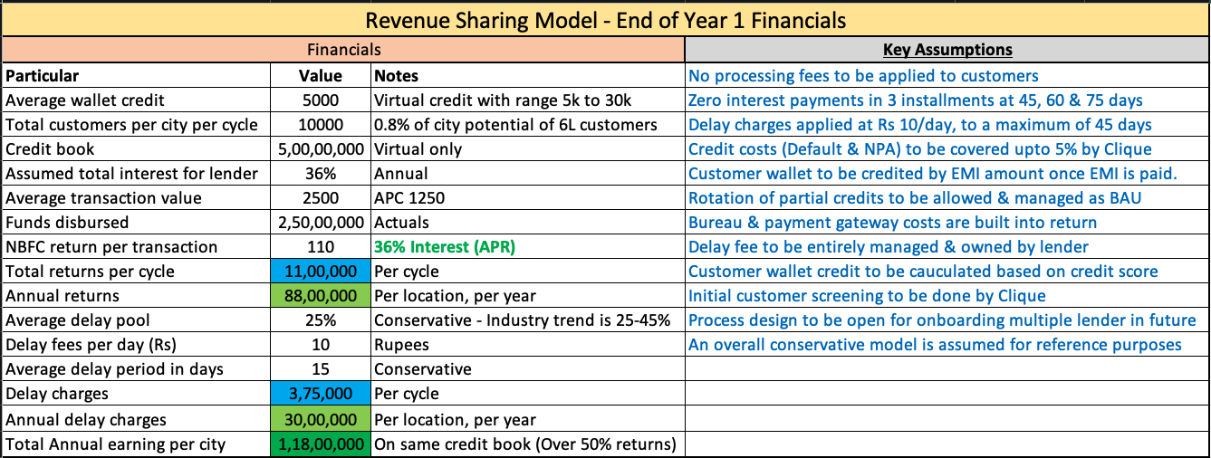
Clique – Revenue Sharing Model – EOY Cycle

Slide 8
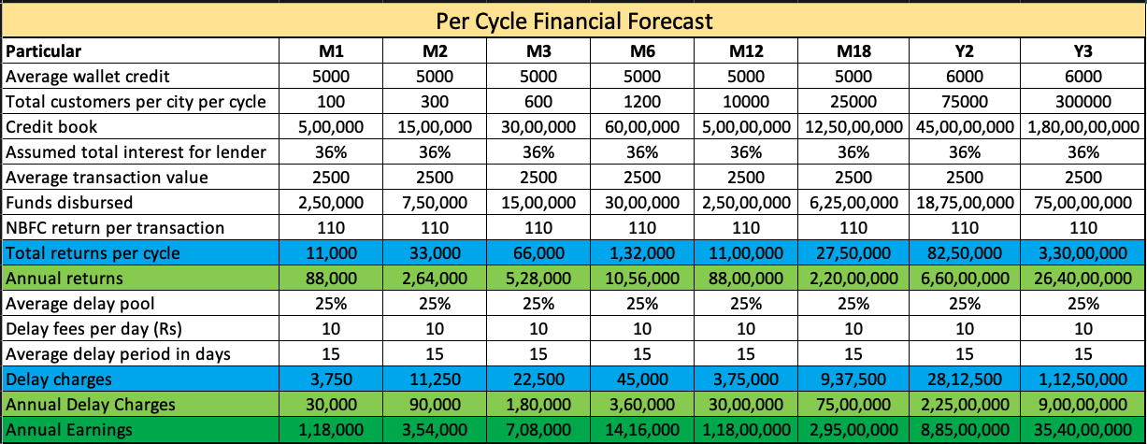
Clique – Financial Forecast
Notes
Conservative assumption that 2nd cycle to start only when 1st on is complete

Slide 9
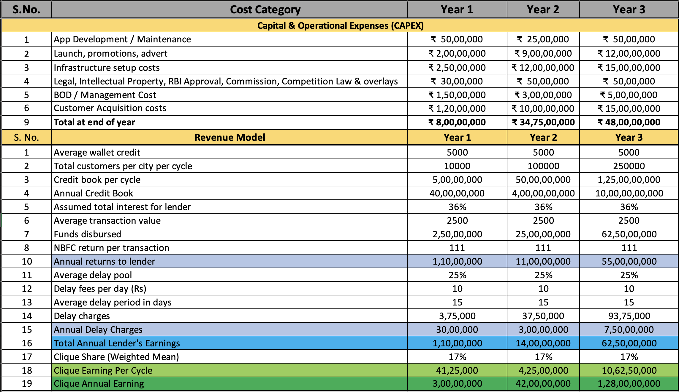
Clique – Revenue & Expenses

Slide 10
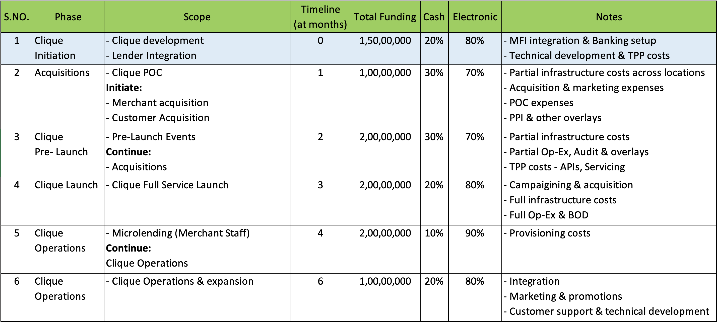
Clique – Phase Costing – Year 1

Slide 11







PAYO (Australia) – A case study
About PAYO
PAYO is an Australian company who have launched the world’s first Eat Now, Pay Later service in July 2021.
The are backed by an existing lender with substantial customer base in the operational regions.
Being the World’s first ENPL app, they have favorably placed themselves as market disrupters, driving investor’s interest & confidence.
Within 3 months of launch, 700+ merchants in 4 cities & growing at the pace of 200 merchants every month
All payments are divided across 4 interest free EMIs, with only a quarter of payment to be made upfront.
Top performing 50 restaurants have received thousands of transactions with recorded order value increase of 60%
Diners can discover restaurants, filter by preferences, call restaurant, book table and receive range of offers & deals.
Both restaurants & customers are incentivized for referring more paying users to the platform
All payments are via PAYO app via QR codes with options for customer to recommend for PAYO business
Instant approval & discreet process has given PAYO an edge over other modes of payments, eliminating need to carry wallets

Slide 12
Customer Acquisition Strategy
Merchant Acquisition Strategy | Consumer Acquisition Strategy | Notes
Direct sales via dedicated regional teams (10 per location per month) | WAIU direct acquisition (6-8k per location per month) | WAIU service acquisitions
Corporate collaborations with multi-location hospitality brands | Aggregation based model to increase time to market | To enable increased time to market
Pre/Post launch promotional & marketing campaigns and events (Pune Mirror) | Social media & network advertisements | Combination of digital & traditional strategies
Network tie-ups and contact center for customer servicing | Event tie-ups e.g., Ridermania, Ruggedian

Slide 13
Merchant – Elevated Pitch
Increased Profit Margins
Of restaurants by onboarding brand new customers & rotate existing customer more often
Staff Lending
For 40+ staff of the restaurant, to reduce salary advances
New Product & Features
To be offered to customers for extended loyalty & addition premium clientele
Larger Ticket Size
Eat Now Pay Later customers to spend an average of 15-30% higher on F&B services
Customer Retention
To continue the quality service & more to existing customers without any added charges
Merchant Lending
To support merchant financial needs without bank audit & documentations

Slide 14
Case Studies – Dining Service Partners
Company / Particular | Dineout | Magicpin | Eazydiner | Devourin
Founded | 2012, Noida | 2015, Gurgaon | 2014, Delhi | 2015, Pune
Owner | Times | Self | Self | Self
Services | Booking, Rewards, Payments, Artists | Discovery, Rewards | Discovery, Payment, Rewards | POS, SCM, Data Analytics, CRM
Coverage | 20 Cities | 40 Cities | 150 Cities | 2 Cities
Acquisition Restaurant / Customers | 50K / 2.5CR | 1.5L / 50L | 10K / 30L | 200 / None
Investments | $100MN (2019) | $43M (2021) | $16M (2020) | $150K (2016)
Revenue | $200M | $10M | $42M | $500K
YoY Growth | 154% (2019) | 415% (2018) | 400% (2019) | TBC
Valuation | TBC | $165M | $40M | $1M

Slide 15
Project Plan – 6 Phased
Phase 06
Q3 2024
Expand in existing 20 Cities & explore additional scope
Target 2400 Restaurants & 3 Lacs Customers per city
Phase 05
Q1 2024
Expand in existing 20 Cities & explore additional scope
Target 2000 Restaurants & 1.5 Lacs Customers per city
Phase 04
Q3 2023
Expand in existing 7 Cities & explore additional scope
Target 1600 Restaurants & 75K Customers per city
Phase 03
Q1 2023
Expand in existing 7 Cities & explore additional scope
Target 1200 Restaurants & 25K Customers per city
Phase 02
Q3 2022
Expand in existing 7 Cities & explore additional scope
Target 800 Restaurants & 10k Customers per city
Phase 01
Q1 2022
Launch in 1 City
Target 400 Restaurants & Convert 1200 Customers
Company Registration : July 2020 - Complete
MVP PoC : Dec 2021
Foundation Period : Q1 2022
Launch : Q1 2022

Slide 16
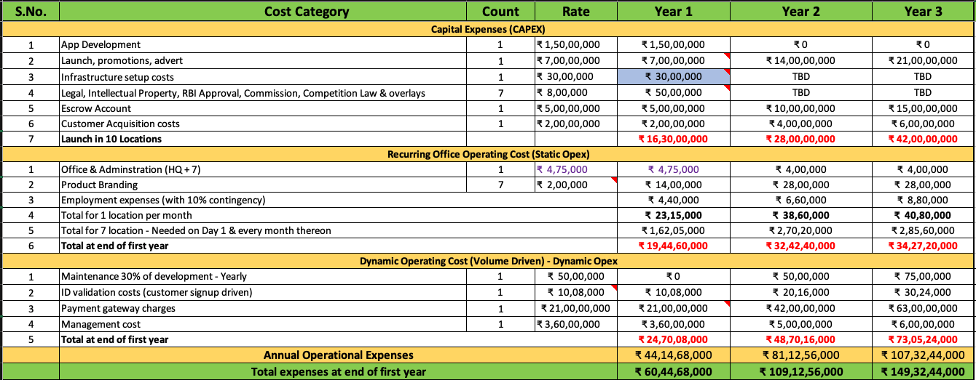
Capital Investment & Operational Expenditure

Slide 17
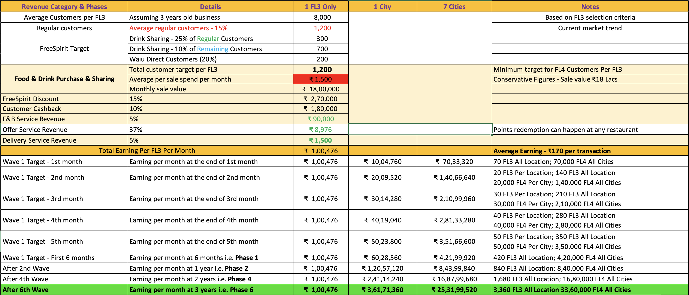
WAIU - Revenue Model

Slide 18
Our Team
Promoters
Rajesh Karandikar
Alok Sambuddha
Board Of Directors
Suhas Gokhale – Managing Director, COSMOS Bank, Pune
Managing Director, Acuris Advisors (GST & Government Policies) – Ex. Big 4 & Tata Motors
Governance Consultant (ex. VP Commercial - Cummins)
Chetan Oswal – Accounts & Legal Counsel
Corporate Partners
KPMG – PPI License Procurement & RBI Regulatory Compliance Partner
Staratacache (SCALA) – Broadcasting & Livestreaming Infrastructure Partner
Early Salary, Loantap, Eazypay (Payu) – Financial Lending Partner

Slide 19






Question & Answers

